Slide 1
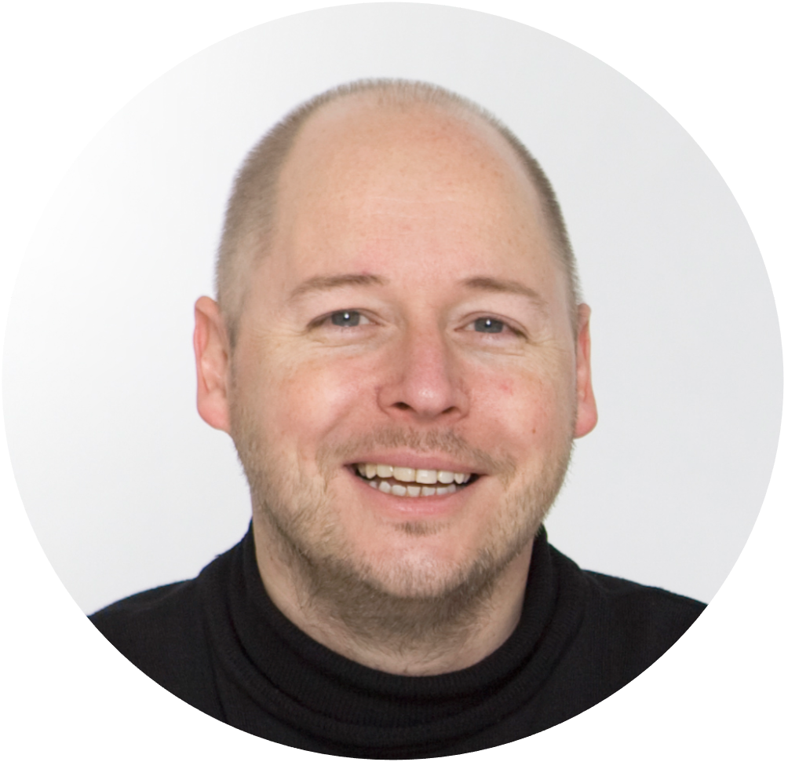

PART 5: Measure and set goals for customer performance
The most popular customer experience metrics
Want us to do it for/with you?
Drop me a line on info@alainthys.com
The customer voice
Notes:
USABILITY
This document uses MONTSERRAT and OPEN SANS fonts. If you do not have these on your computer, you can download them for free on https://fonts.google.com.
TERMS OF USE
Non-photographic content
Except where otherwise noted, the non-photographic content in this document is licensed under a Creative Commons Attribution-ShareAlike 3.0 Unported license. In human language this means that you can freely copy and redistribute the material and remix, transform and build upon it as long as you:
Give appropriate credit by mentioning the author. In this case: (cc) Alain Thys/Customerfit
Provide a link to the creative commons license
Indicate any changes that were made to the original material
Do not pretend that any changes you made are endorsed by Customerfit or Alain Thys if you haven’t discussed this with us first
If you remix, transform, or build upon the material, you must distribute your contributions under the same license as the original
You may not apply legal terms or technological measures that legally restrict others from doing anything the license permits.
Photography
Unless otherwise noted, photographic (and occasionally video) imagery remains the property of its respective rights owners and has only been licensed by Customerfit for use in this presentation. Without additional permissions you cannot modify them, copy them into other presentations or otherwise publish them (e.g. on websites or elsewhere). If you decide to to this, the original rights holder may ask for indemnities.
Icons
Icons have been sourced from The Noun Project. Licensing terms apply, but their lowest price subscription starts at $0 (for non-commercial use). So if you want to use them, just head over there and do the right thing.
Trademarks
The Customerfit trademark is the property of Shalima BV. All other trademarks are the property of their respective owners.

Slide 2
89%
38%
16%
Net Promoter Score
Customer Satisfaction Score
Customer Effort Score
Source: MIT/Customergauge 2018
The customer voice

Slide 3

Net Promoter Score (NPS)

Slide 4
Fred Reichheld
Net Promoter Score

Slide 5
On a scale of 0-10: How likely is it that you would recommend [brand] to a friend, colleague or family member?
0
1
2
3
4
5
6
7
8
9
10
Net Promoter Score =
% promoters
-
% detractors
Net Promoter Score

Slide 6

Customer Effort Score (CES)

Slide 7



Customer Effort Score

Slide 8

The organisation made it easy for me to handle my {issue of relevance}
Strongly disagree
Disagree
Slightly disagree
Slightly agree
Agree
Strongly agree
Customer Effort Score = average
Customer Effort Score

Slide 9

Customer Satisfaction Score (CSAT)

Slide 10
How would you rate your experience with our product/service/company?
Very
unsatisfied
Unsatisfied
Neutral
Satisfied
Very
satisfied
%
Customer Satisfaction Score
Customer Satisfaction Score (CSAT)

Slide 11


How likely are you to recommend?
Customer Satisfaction Score (CSAT)

