Slide 1
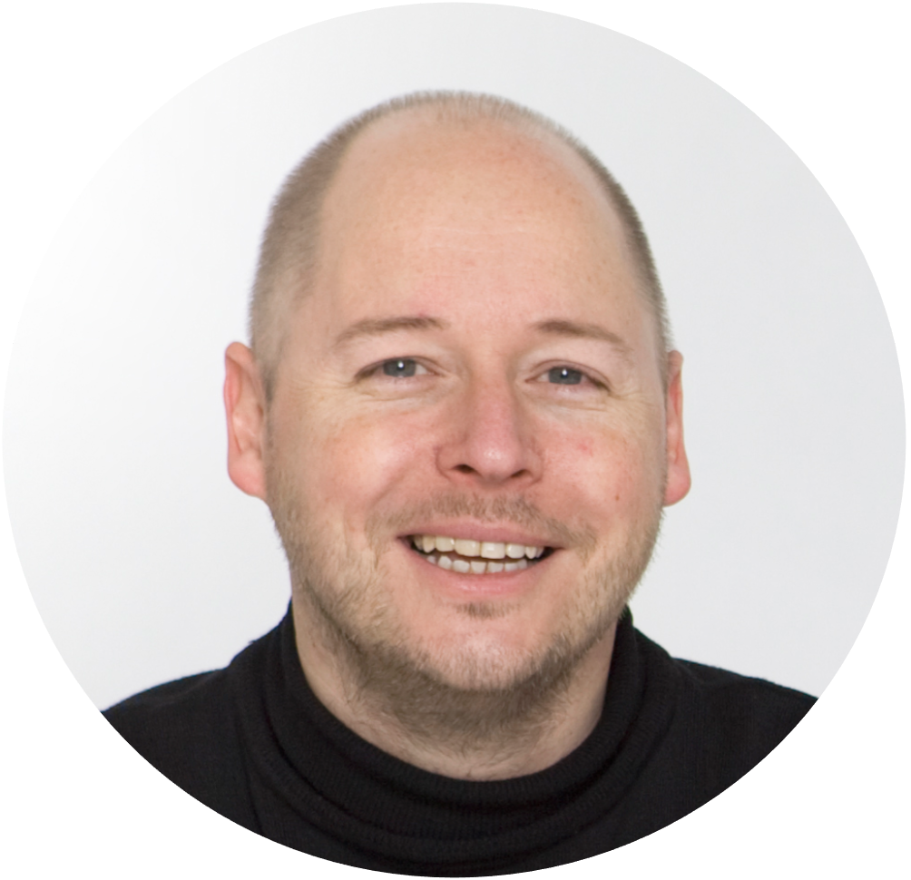
PART 7: Make the customer voice happen
Kick off your customer voice programme
Want us to do it for/with you?
Drop me a line on info@alainthys.com
The customer voice
Notes:
USABILITY
This document uses MONTSERRAT and OPEN SANS fonts. If you do not have these on your computer, you can download them for free on https://fonts.google.com.
TERMS OF USE
Non-photographic content
Except where otherwise noted, the non-photographic content in this document is licensed under a Creative Commons Attribution-ShareAlike 3.0 Unported license. In human language this means that you can freely copy and redistribute the material and remix, transform and build upon it as long as you:
Give appropriate credit by mentioning the author. In this case: (cc) Alain Thys/Customerfit
Provide a link to the creative commons license
Indicate any changes that were made to the original material
Do not pretend that any changes you made are endorsed by Customerfit or Alain Thys if you haven’t discussed this with us first
If you remix, transform, or build upon the material, you must distribute your contributions under the same license as the original
You may not apply legal terms or technological measures that legally restrict others from doing anything the license permits.
Photography
Unless otherwise noted, photographic (and occasionally video) imagery remains the property of its respective rights owners and has only been licensed by Customerfit for use in this presentation. Without additional permissions you cannot modify them, copy them into other presentations or otherwise publish them (e.g. on websites or elsewhere). If you decide to to this, the original rights holder may ask for indemnities.
Icons
Icons have been sourced from The Noun Project. Licensing terms apply, but their lowest price subscription starts at $0 (for non-commercial use). So if you want to use them, just head over there and do the right thing.
Trademarks
The Customerfit trademark is the property of Shalima BV. All other trademarks are the property of their respective owners.

Slide 2
Build your sprint team

Slide 3
BUILD YOUR SPRINT TEAM
Sprint
sponsor
Customer intelligence
IT, systems & customer data
Customer facing colleagues
Training & development (HR)
Internal communication
Project management
Kick off your customer voice programme
Customerfit
3.

Slide 4
Team member | Role | Activity level
Sprint leader | The sprint leader is the person who makes the sprint happen. They make sure that meetings take place and information is collected and organised in the right way. As there may be many conflicting organisational priorities, they also act as the customer’s champion at all times. | High
Sprint sponsor | The sprint sponsor is a – preferably senior – executive who supports the sprint leader with advice, resources and occasional political support (if the organisation needs a nudge). They also help the sprint leader right-size their ambition level to the organisation’s willingness and ability to execute. | Low
Customer Intelligence | The customer intelligence representative is someone who is up to date on the existing market research and customer analysis efforts. They supports the team with insights into existing efforts, as well as suggesitions on the way to inegrrate customer voice efforts with these initiatives.on | Medium
Customer facing colleagues | In the process steps where the team gets the customer perspective on the work being done, the customer-facing team members contribute their experience in initiating and interpreting customer conversations. Also, based on their experience, they can credibly fill in the blanks where customer answers may not be 100% clear. | Medium
Training & develop-ment (HR) | The training & development (HR) team member needs to make sure that, once they have been defined, the customer experience standards are clearly communicated throughout the business + brought to life where possible. By involving them from the start of the process, they are fully aware of the background to all decisions that have been made. | First low, then high
Team member roles
Customerfit
4.
Notes:
The actual size composition of your sprint team will differ based on your organisational setup and ambition level. Typically five roles are required for any team working on customer experience standards.
This slide summarises these five roles, while also giving an indication of the activity level/workload for each team member.

Slide 5
The kick-off meeting

Slide 6
PURPOSE
Understand:
The customer voice programme concept
How it applies to the company
Implementation plan
AGENDA
Why focus on the customer voice?
The components of a customer voice programme
The implementation plan ahead
The task of the sprint team
Getting ready to build the prototype
Kick off your customer voice programme
Notes:
For a better understanding of this slide, please refer to the video of this module.

